Slide 1
A Comparative Analysis of Transfer Learning Approaches for Malware Classification Using Convolutional Neural Networks
Name: Onyedika Christopher Agada
Student Nos: 214306911
Program: Masters in Cybersecurity
Institution: Uskudar University
Advisor: Assoc. Prof. Dr. A.H. Abdul Hafez
Date: 2025

Slide 2
Outline
Introduction
Background
Methodology
Transfer Learning Techniques
CNN Architectures Used
Results Overview
Discussion of Findings
Contribution
Challenges and Limitations
Conclusion
Q & A

Slide 3
Abstract
Malware presents a considerable danger to the reliability and safety of computer systems, covering a diverse array of malicious software, comprising trojans, worms, spyware, ransomware, viruses and hardware. This study explored the comparative analysis of transfer learning approaches for grouping malwares by family using convolutional neural networks (CNNs). By employing transfer learning from top-performing architectures, such as EfficientNetB0, ResNet50, DenseNet169, XceptionNet, VGG16 and InceptionResNetV2. MalImg and MaleVis training datasets were employed to train and validate the CNN models, which are renowned benchmarks in the malware analysis field and through extensive experimentation and evaluation, the suggested approach achieved impressive accuracies, ranging from 77% to 96% after classification. The results demonstrated the capacity of transfer learning employing various architectures to improve the performance of CNNs in accuracy-based malware classification tasks.

Slide 4
Introduction
Context: The cybersecurity landscape is increasingly threatened by malicious software (malware), which encompasses various types such as viruses, worms, ransomware, and spyware. Malware attacks are projected to cost the global economy $10.5 trillion annually, highlighting the urgent need for effective malware detection and classification methods.
Problem Statement: Conventional malware detection techniques, mainly reliant on signature-based antivirus programs, struggle to identify new or encoded malware, leading to significant gaps in security. The complexity and evolving nature of malware necessitate advanced methods beyond traditional static and dynamic analysis. Furthermore, existing deep learning approaches face challenges such as limited training data, overfitting, high computational costs, and interpretability issues.
Objective: This study aims to conduct a comparative analysis of Convolutional Neural Networks (CNNs) for malware classification using transfer learning from various architectures. By leveraging datasets like MalImg and MaleVis, the goal is to enhance CNN performance and achieve high classification accuracies, thereby improving the reliability and safety of computer systems.

Slide 5
Background
The background of this research lies in comparing different renowned top-performing CNN architectures to determine the best architecture for classifying malicious software.
Conventionally, malicious software identification depends on signature-based techniques, which, even though effective for known threats, grappled with new or altered malicious software . This setback demanded the exploration of more high-level techniques, such as deep learning and machine learning.
Convolutional Neural Networks (CNNs) are a type of deep learning models that was designed to be used in the processing of image data and computer vision.
CNNs have shown capacity in image classification because of their ability to extract and learn features automatically. In malicious software detection, CNNs can be used to examine malicious software binaries as images, which enables the identification of patterns that imply different malicious software families.
Transfer learning has also emerged as a powerful method in deep learning, which allows models that are trained on large datasets to be adjusted for tasks with reduced data.
This study investigates the comparison of state-of-the-art CNN architectures: XceptionNet, EfficientNetB0, ResNet50, VGG16, DenseNet169, and InceptionResNetV2 in malicious software classification.

Slide 6
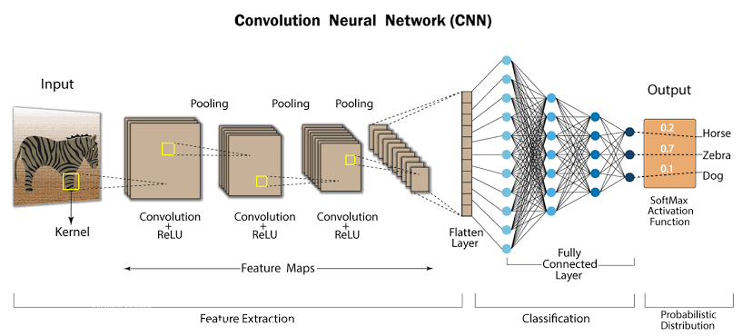

Slide 7
Convolutional neural networks work by using the input layer to receive raw data from an input image, the convolutional layer and pooling layers extracts and concentrate the features from the input data. Lastly, the fully connected layers examine and classify the features and produce a final output.
Transfer learning is a machine learning technique where a model developed for one task is introduced as the starting point for another model on another task. Transfer learning is used to increase the performance of image classification models that has limited training data. Transfer learning leverages the information gained from pre-trained models on huge datasets to increase the performance on a new smaller dataset.

Slide 8
Key Aspects of Transfer Learning
Pre-trained Models
Feature Retention
Fine-tuning
Domain Adaptation

Slide 9
Benefits of Transfer Learning
Reduced training time
Improved Performance
Less Data Required

Slide 10
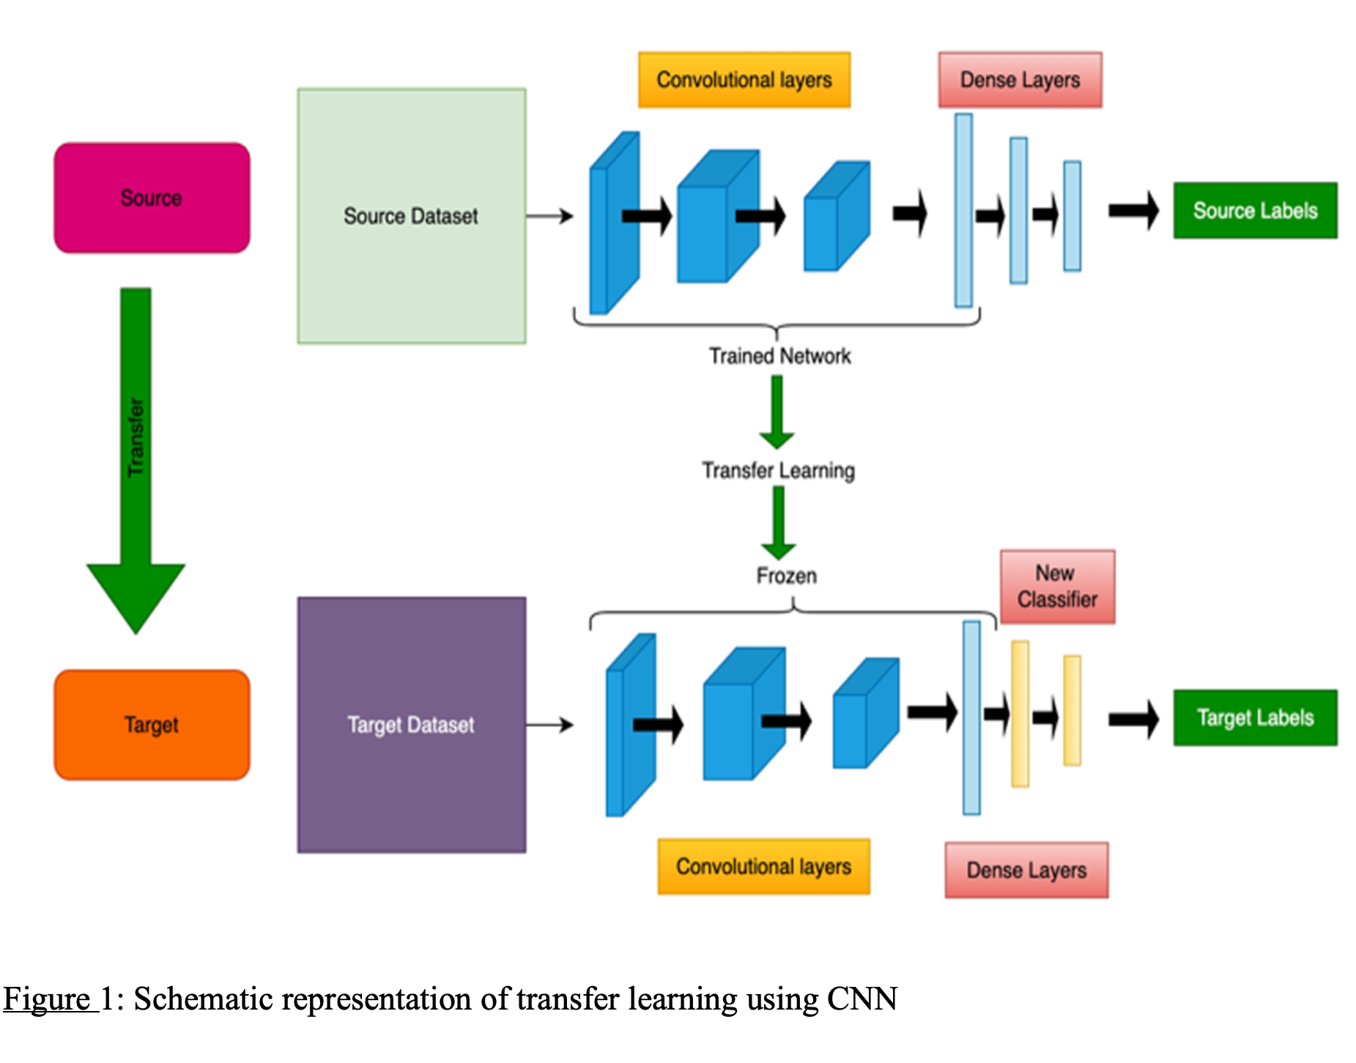
Methodology

Slide 11
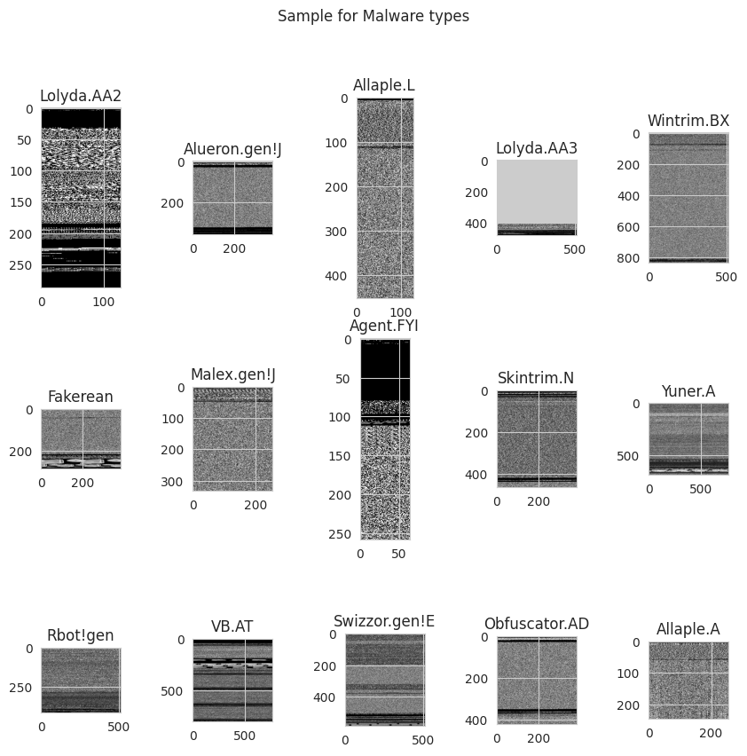
Datasets

Slide 12
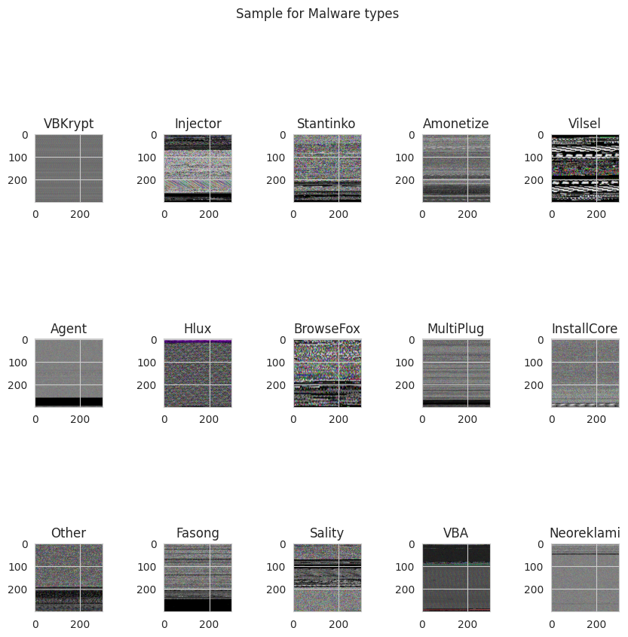

Slide 13
Approach: This study employs transfer learning from established architectures, including EfficientNetB0, ResNet50, DenseNet169,XceptionNet, VGG16 and InceptionResNetV2. These pretrained CNN models, initially trained on the ImageNet dataset, leverage learned visual features to enhance malware classification.
Datasets: The analysis utilizes two key datasets: MalImg and MaleVis datasets
Data Preprocessing: Images are resized, normalized, and augmented to enhance diversity and quality for training.
Model Training: Pre-processed data is fed into CNN models. The early layers of pretrained models are frozen to preserve learned features. New layers are added for classification, including a Dense layers with ReLU activation function and dropout layers to mitigate overfitting. A final classification layer with 25 units representing malware families, using a softmax activation function is also added.

Slide 14
CNN Architectures
EfficientNetB0: This network is made up of 28 layers, including 14 convolutional layers, 6 max-pooling layers, and 3 fully connected layers.
ResNet50: The ResNet50 network contains 50 layers, including 48 convolutional layers, 6 Max Pooling layers, and 3 fully connected layers.
VGG16: The VGG16 comprises of 13 convolutional layers, 5 Max Pooling layers, and 3 fully connected layers, bringing it to a total of 21 layers.
DenseNet169: DenseNet169 has 169 layers which allows it to effectively capture complex patterns in the input data. It consists of 162 Convolutional layers which extracts features from the input image, 4 Max Pooling layers which reduces the dimensionality of the feature maps and 3 fully connected layers which are used for the classification.
XceptionNet: This CNN model consists of 71 layers.
InceptionResNetV2: This network is comprised of 164 layers.

Slide 15
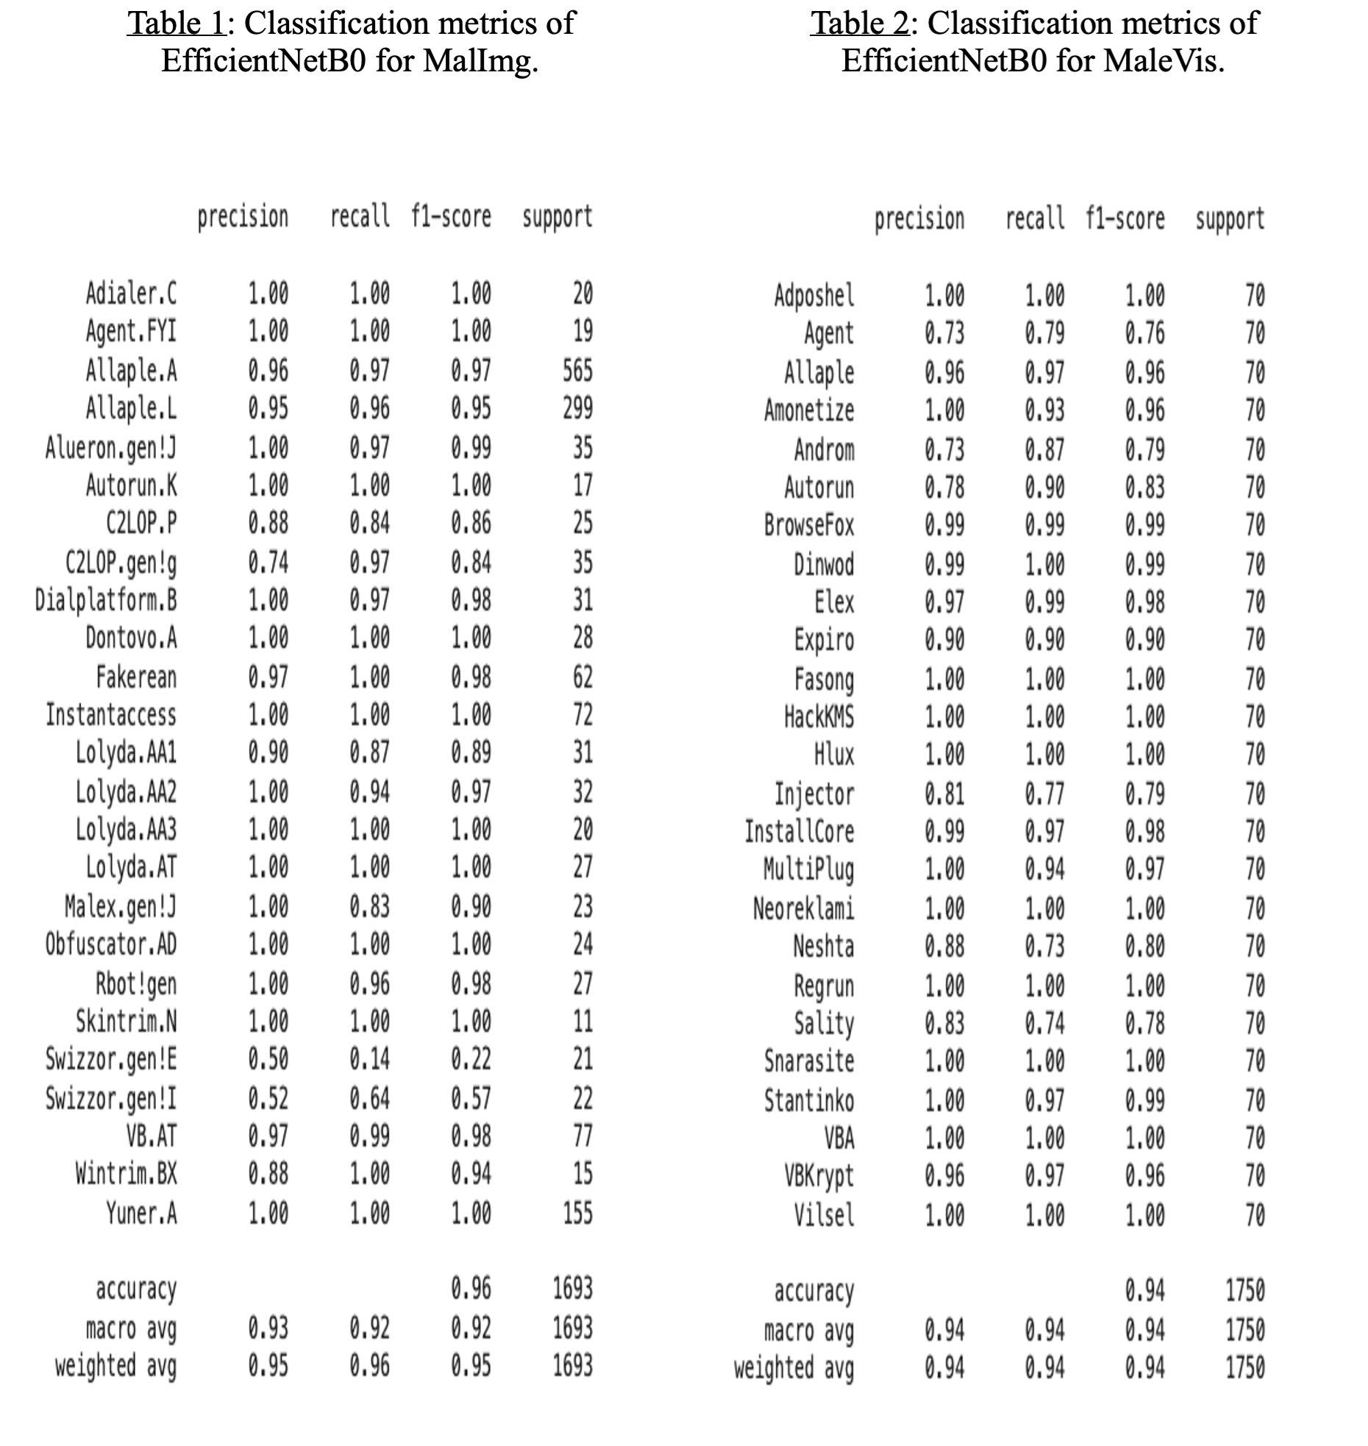
Results

Slide 16
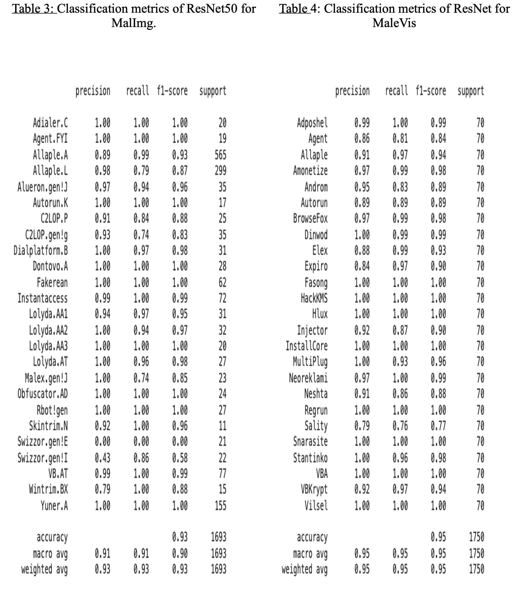

Slide 17
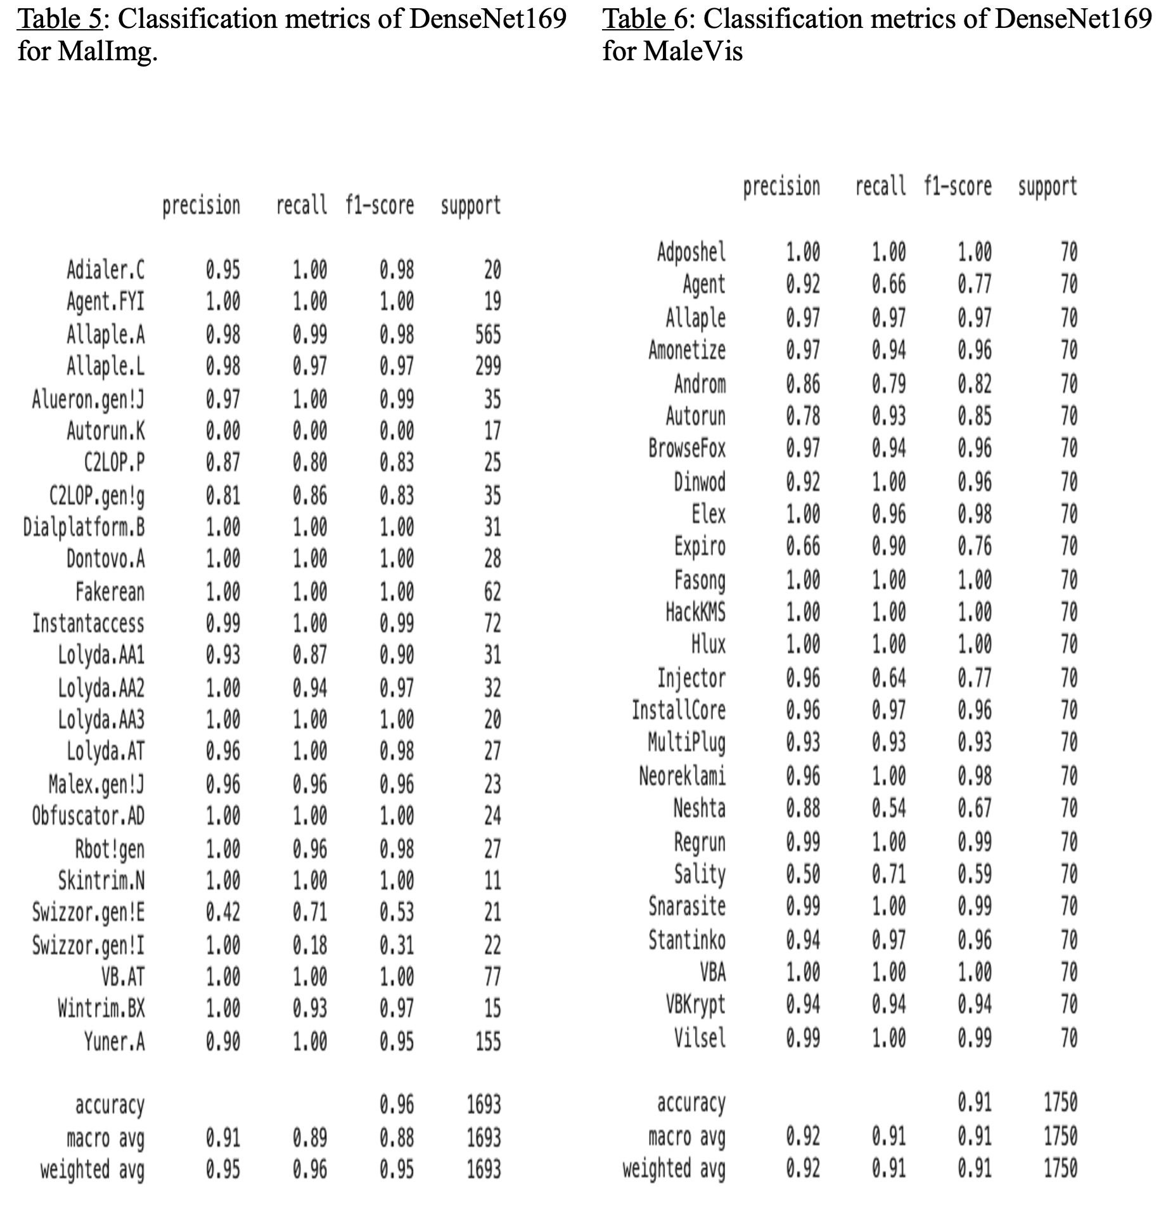

Slide 18
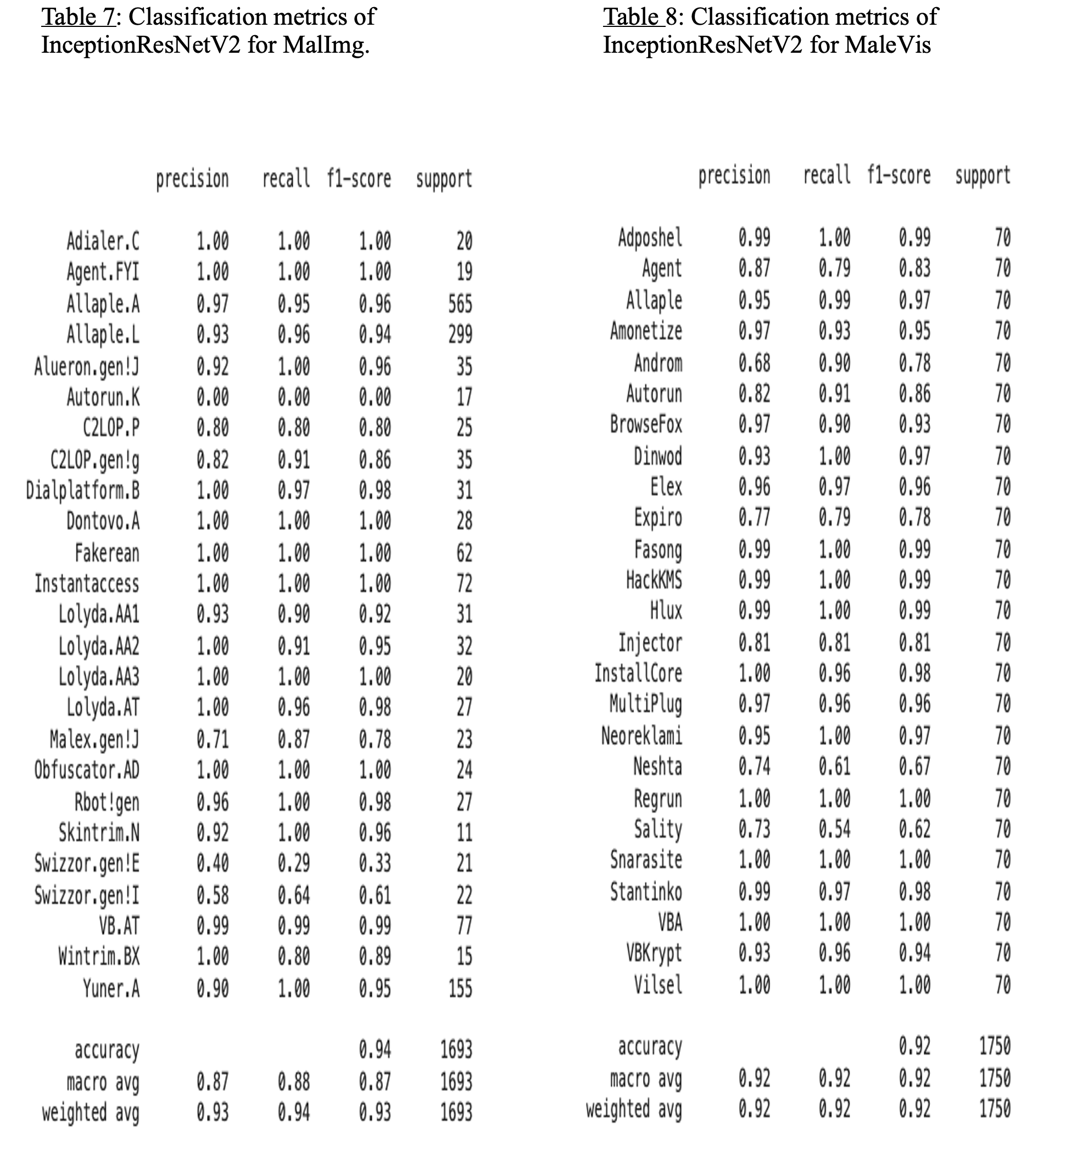

Slide 19
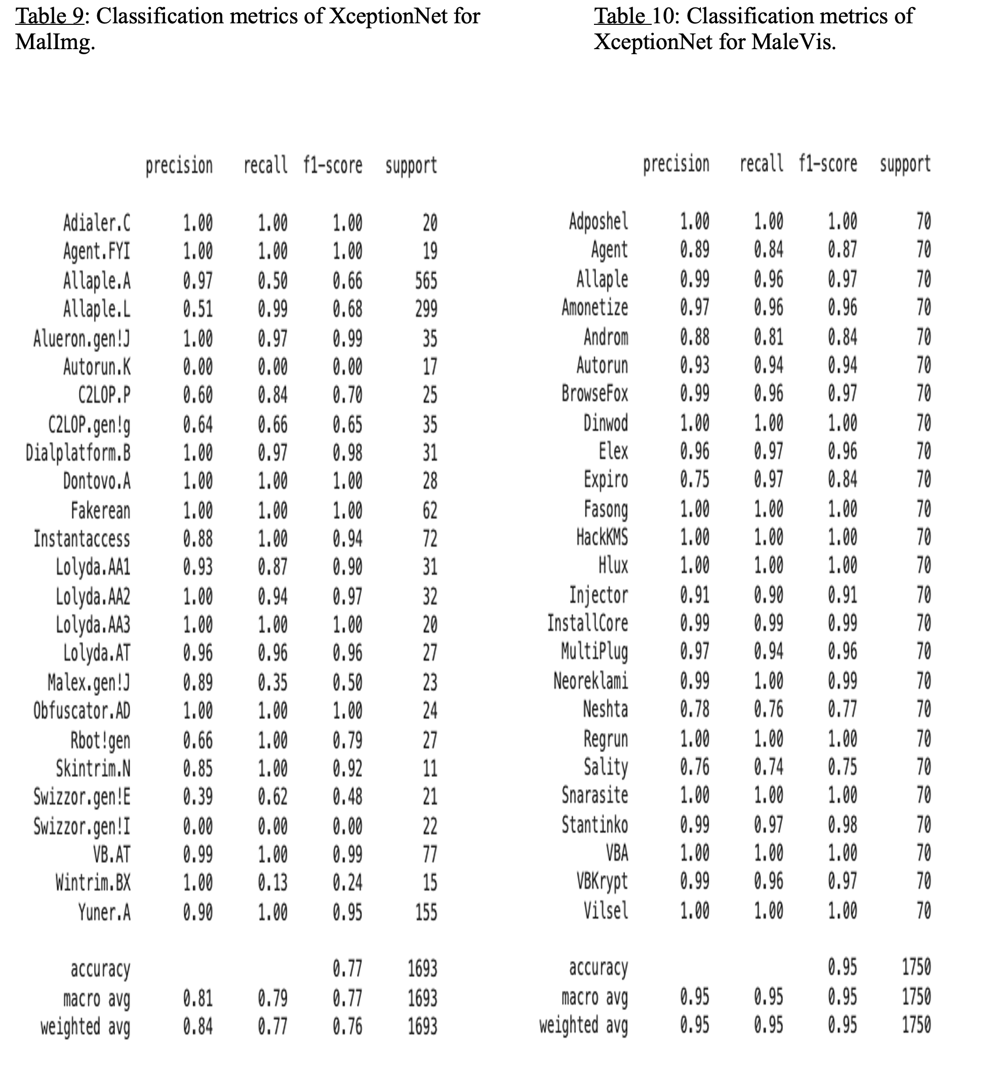

Slide 20
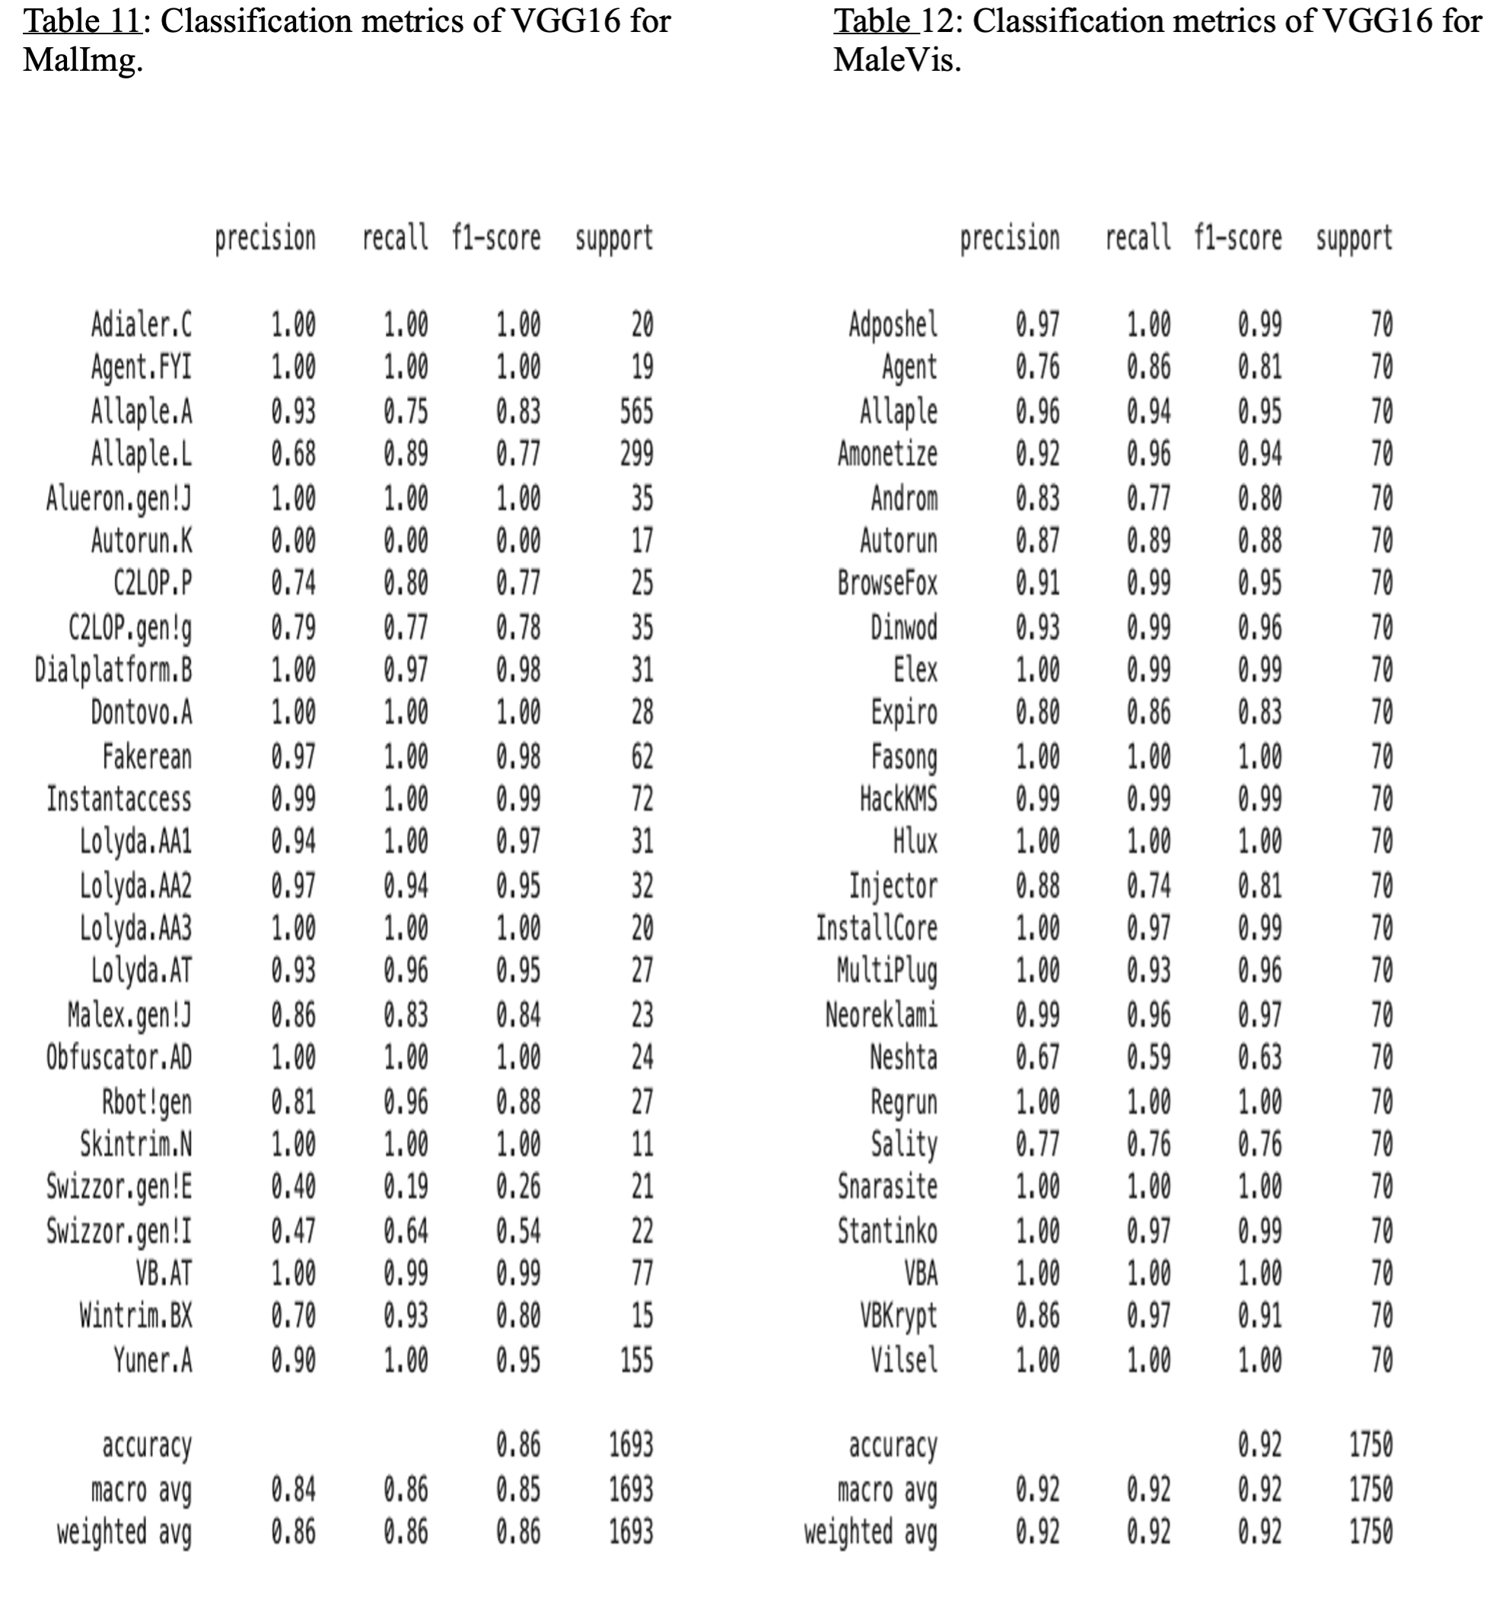

Slide 21
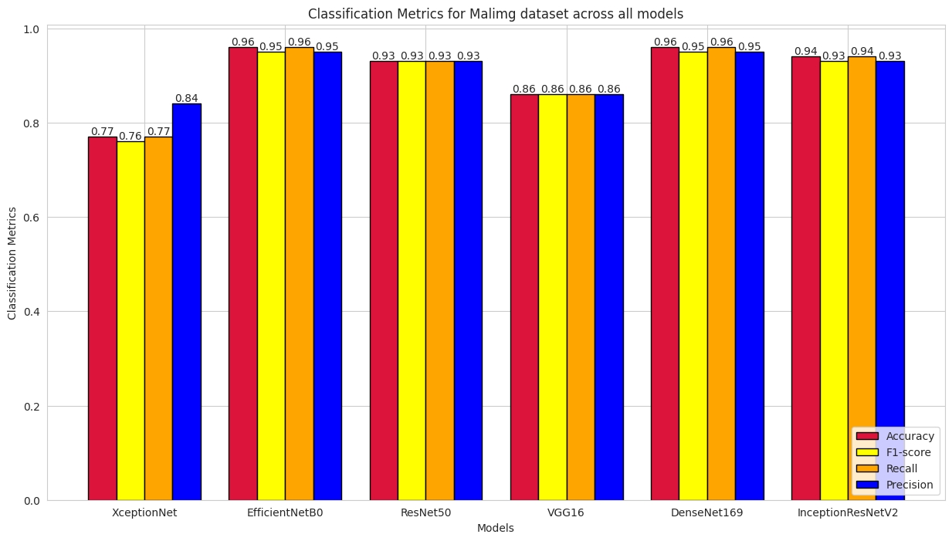

Slide 22
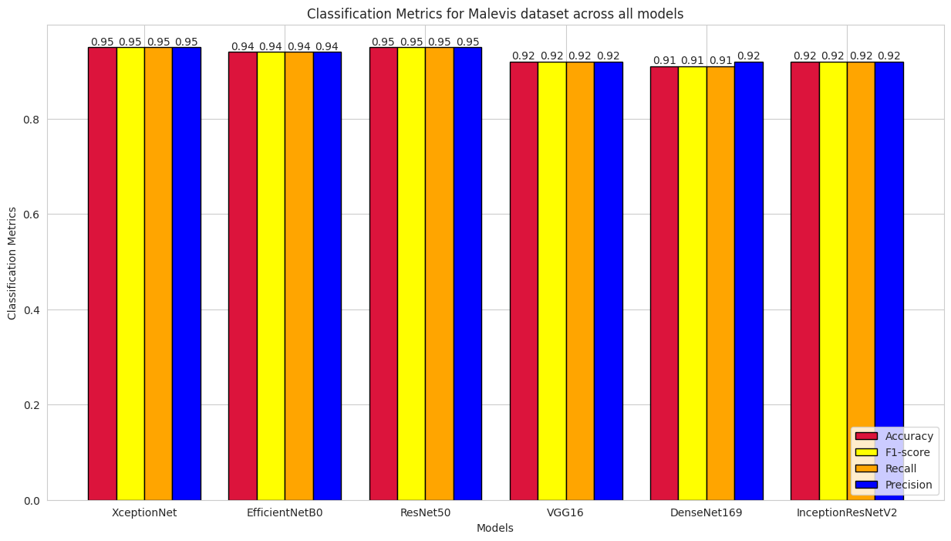

Slide 23
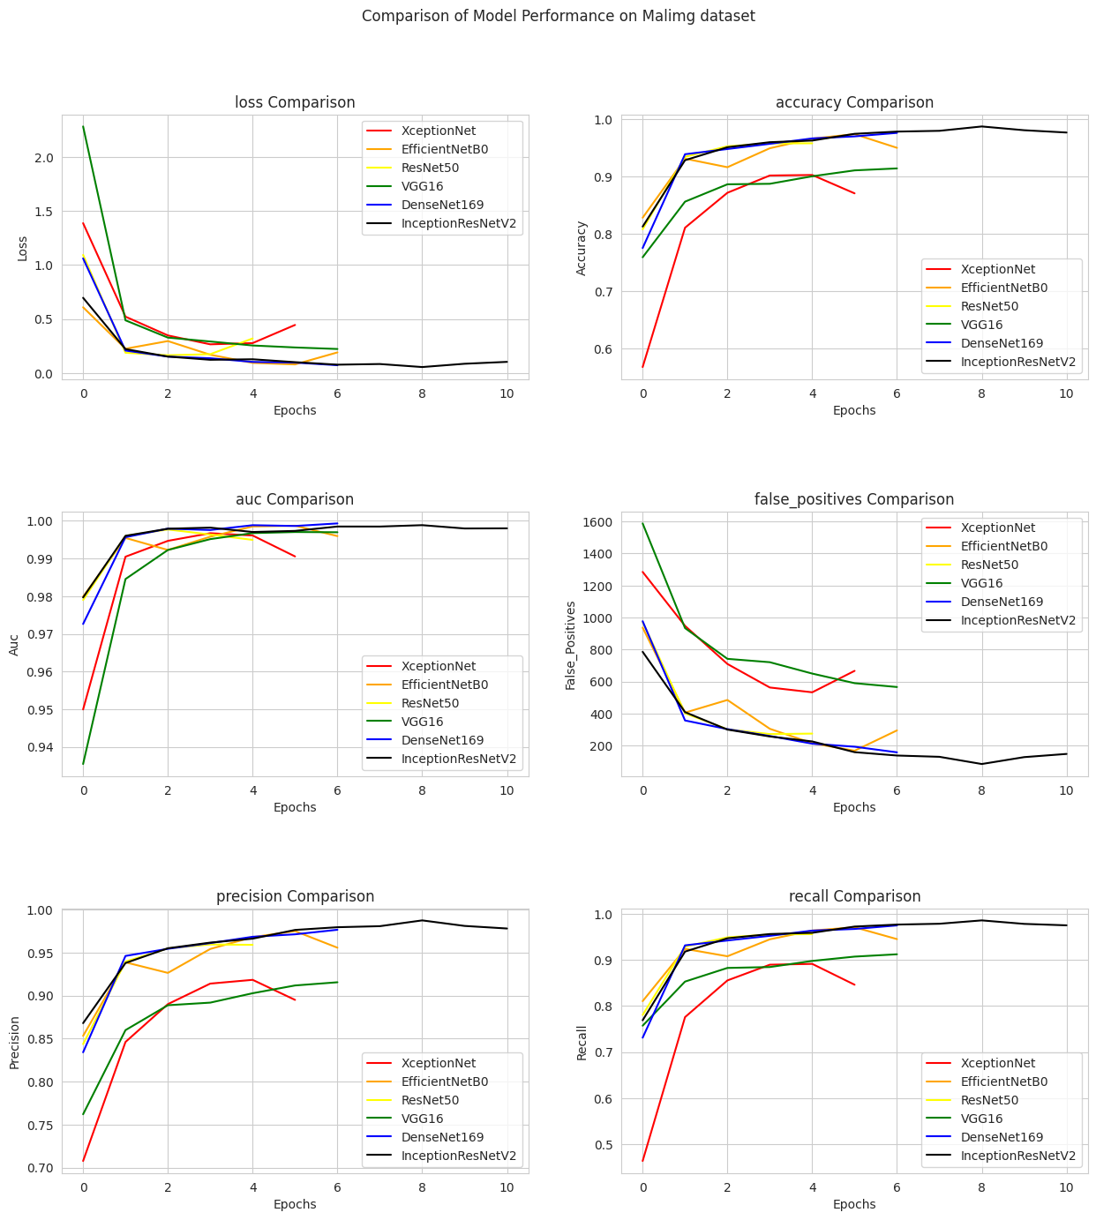

Slide 24
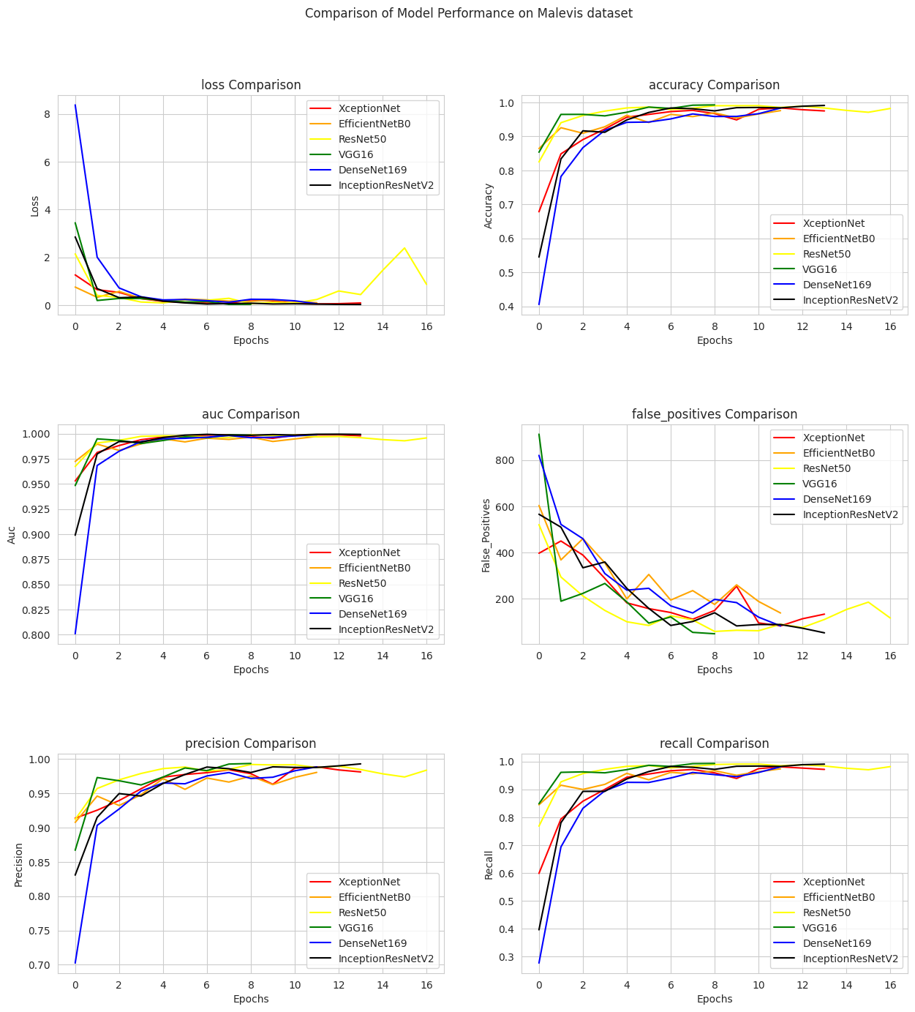

Slide 25
Discussion of Findings
Key Insights:
High accuracy achieved across architectures.
Transfer learning effectively enhances malware classification performance.
The performance metrics: accuracy, precision, recall, F1-score, AUC, and both macro and weighted averages have provided valuable insights into the effectiveness of each model in handling classification tasks.The results indicate that while all evaluated architectures demonstrate varying degrees of success in identifying malware, certain models exhibit superior performance due to their unique architectural features and the benefits derived from transfer learning.

Slide 26
Contribution
Advancements in Deep Learning for Cybersecurity
Strong Cybersecurity Defenses
Efficient Detection of Malicious Software
Enhanced Malicious Software Classification Accuracy

Slide 27
Challenges and Limitations
Class Imbalance
Overfitting
High Computational cost

Slide 28
Conclusion
In summary, the analysis highlights that EfficientNetB0 and DenseNet169 emerged as the top-performing models, achieving high accuracy rates on both the MalImg and MaleVis datasets. The results indicate that while these models excelled in detecting common malware families, they also exhibited challenges with minority classes, suggesting a potential bias towards more prevalent categories.The comparison of performance metrics across all models underscores the importance of selecting appropriate architectures based on specific classification tasks.
future studies can explore the following:
Investigating hybrid architectures which may yield improved performance and better efficiency.
Incorporating larger and more diverse datasets to enhance model robustness and generalization.
Implementing techniques such as oversampling or synthetic data generation to help improve detection rates for minority classes.
The integration of these approaches into real-world malicious software identification systems to improve their accuracy.

Slide 29
Q & A
Thank you for your time and attention
I welcome any questions and remarks.

